Slide 1
Who Am I: Kathrine Beard Company: Magnificent Baby Product: Infant clothing with magnetic fastenings- Night Gowns
Who are you: Shirley Beard
Company: Itty Bitty’s Closet; Owner
**Children’s Clothing Store
**New & Used Clothing & Merchandise

Slide 2
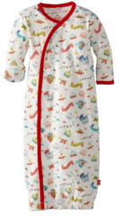
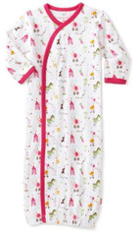
Boy
Girl

Slide 3
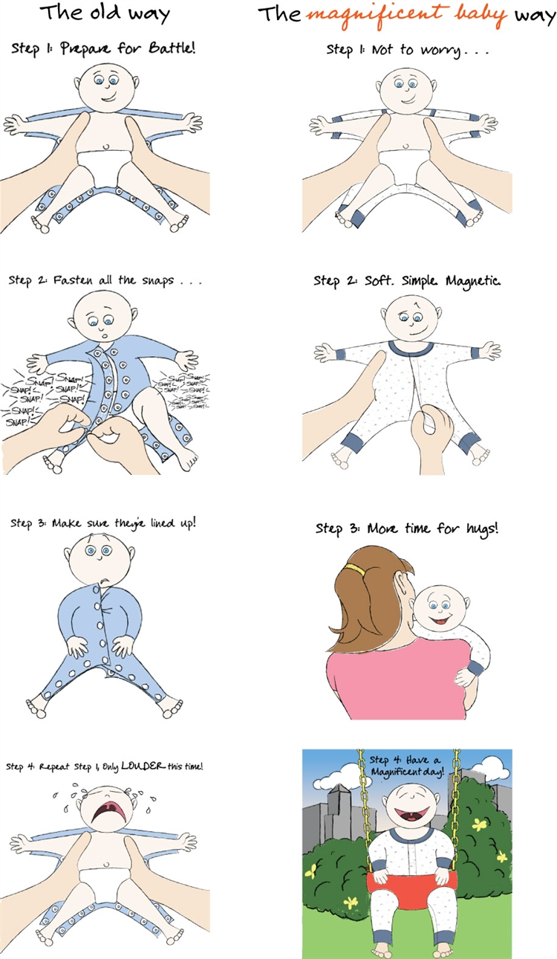

Slide 4
We Want You!

